Slide 1
Mechanisms for Data Safety and Security
HIV, Human Rights and Sustainability: From Analysis to Action
Presented by Hally Mahler, Project Director, LINKAGES Across the Continuum of Services for Key Populations Affected by HIV (LINKAGES)
Notes:
I’m not really sure how I ended up on this podium tonight in such distinguished company. I’m not from the UN or global human rights organization. Nor am I an expert on data safety and security. So what you won’t get from me tonight is a list of the copious number of global agreements on human subjects research or information on data collection techniques. What I am, instead, is an implementer of programs. I’ve been doing this work for 25 years. And as you heard, I am currently the director of global key populations project being implemented in 30 countries. We work through local community-based organizations, and whenever possible through KP-led organizations. We adhere to the principles of “nothing for us, without us” and “do no harm”. Every day I think about the heavy responsibility we have to collaborate with KP communities in protecting the information they share with us so that we can together implement successful programs – be it through research activities or routine data collection. We collect and use an enormous amount of data. We are PEPFAR-funded and have certain standard indicators we are required to report on. And in order to better understand our beneficiaries we also collect data on custom indicators and conduct formative research. And then in order to ensure that we are reaching the “right people in the right places the right way” our CSO partners have a big workforce of peer educators, peer navigators, peer mobilizers, health providers etc., and these people use things like outreach diaries, referral forms, government registers, and other tools to help them do their work.
Like I said. There is a lot of data out there. And even though we have internal systems to protect the data, our systems are sometimes challenged.

Slide 2
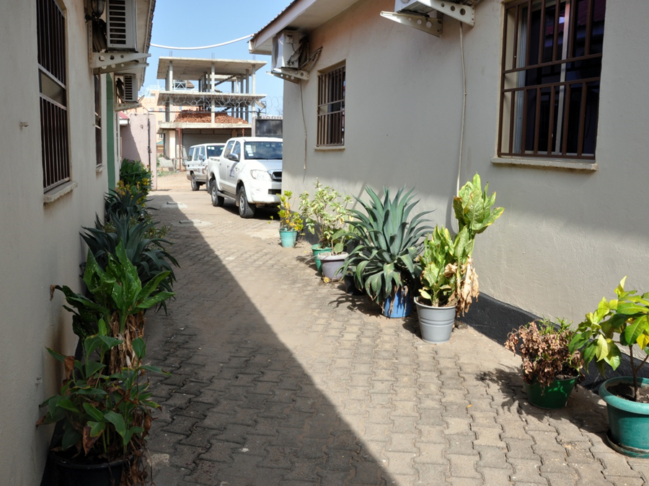
A Story from South Sudan
KP Drop in Center
Notes:
I want to start by telling you a story about South Sudan. Although it is not in the regions we are discussing tonight, South Sudan is about a rights-constrained environment as you have find for KPs. Not very long ago, there was a behavioral surveillance survey underway in South Sudan that included, among other populations, men who have sex with men. It wasn’t implemented by LINKAGES, but since we work with the CSOs that work with MSM the implementers naturally approached those organizations to help them implement their study and they hired the peer educators that also worked for LINKAGES and we agreed to let the peer educators have their work organized out of the drop in center we supported. Just before data collection ended, one of the peer educators out recruiting participants for the study was arrested by the National Security Forces. Now the researchers had done the work that they needed to prepare the local police, but no one anticipated that the elite security forces would be an issue. Although the person told them he was working on a study and produced documentation that showed so, the people who arrested him beat him up badly and forced him to take them to where he was working – and so he led them to the drop-in-center. At the drop-in-center two more MSM were arrested as were four project staff - 7 in total. Telephones and computers which held study data and project data were confiscated. The staff were released within a day but the MSM were held by the police and beaten for several more days, and then all but one was released. The one who continued to be held was beaten by the police on a daily basis, and forced to open his phone and share his contacts, he was forced to bring the police to other places where the MSM program worked. Despite the fact that the Ministry of Health and the National AIDS Program knew about the study, and tried to intervene on behalf of the man, and the international community mobilized to free him, he was held for about 4 weeks until the South Sudan AIDS Commission managed to convince the military leader to do so. During part of this time, the LINKAGES office – which also shared space with other projects – was closed down for several weeks. And the Drop-in-Center remains closed to this day.
I could share many more stories like this with you. Like the time the regional office of a KP project in another country was raided by the police and the door knocked down with a battering ram. They were trying to “confiscate the lubricant””, but there was confidential data in that office, too, because MOH client cards were being input into the encrypted database maintained by the project. While some members of the team held off the police, the data managers inside worked to make sure that the hard copies were secured and the computers were protected. But programs don’t always have a several hour stand-off to protect their data.
And then there was the time in Burundi when a peer educator was arrested and beaten and forced to share the contacts on his password protected phone. Some members of the police then lured in other MSM with text messages and arrested them, too.
In Uganda, the office of FARUG—a CSO supporting LGBTI community members—was broken into by unknown people. No members of the organization were present at the time, but evidence indicates that the perpetrators aimed to steal data and intimidate the staff. Computers, printers, a server, documents, and a database of members were stolen, while a jerry can of acid and a large metal pipe were placed in the compound.

Slide 3
Data is Necessary in Order to Ensure Adequate Resources and Access to Tailored Services for KPs
Surveillance
Geographic distribution of KPs
Size estimations
Behavioral surveys
Programmatic data that tells us where populations are, where the greatest needs exist, and how we are doing against targets down to a granular level
Notes:
OK… so I just told you some bad stories. But the truth is, for every bad story there are many more stories where things have gone smoothly. However, even when data collection is smooth and the data is safe and secure, it is hard to know in rights-constrained environments if what you have is really accurate data because criminalization and prosecution discourage participation in services and research. The criminalizing environments in which KPs live and seek services are inherently unsafe and pose a threat to both the key populations themselves and to their service providers.
On this slide you can see a list of some of the types of data that is necessary in order to ensure adequate resources and access to tailored services for KPs. If we don’t try to properly enumerate KPs, understand where they are, how many there are, understand behavioral and structural facilitators and barriers and collect and use programmatic data at the granular level we create another threat – which is that KPs do not get recognized as groups and individuals in need of services and it is harder to monitor the success of programs and make improvements to them.

Slide 4
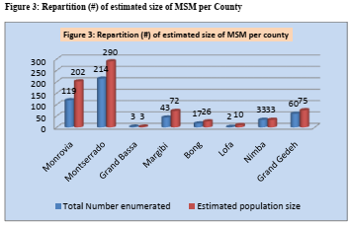
The Damage Done by Poor Data
Technical Report: Size Estimation of Sex Workers, Men Who Have Sex with Men
and Drug Users in Liberia, December 2011
Notes:
Poor and inaccurate data is another danger iecause the techniques we typically use to enumerate KPs often don’t work well in rights-constrained environments. A classic example is this Size Estimation of Sex Workers, Men Who Have Sex with Men and Drug Users in Liberia done in December 2011. In this study, researchers visited some suspected MSM hotspots at the county level, counted people they thought might be MSM, and created a size estimate of 711 MSM in all of Liberia – a country of 4.5 million people. I wish I could say that this happed 7 years ago and things are better now, but we still see inappropriate size estimations – done using methodologies that are insufficient to allow us to categorize the KP population, and not taking into account the advent of social media and the copious presence of otherwise hidden KPs who can be found online but not in traditional hotspots.

Slide 5
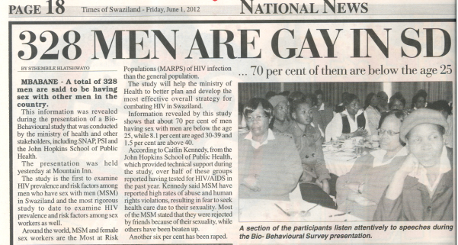
Both Good and Poor Data Have the Power to Harm KPs
Notes:
Even when the data are good, the media and other stakeholders can get it wrong, as we see in this article in the Swaziland press from 2012 where participants in a RDS study were reported as the total number of gay men in Swaziland.
So… both good and poor data have the ability to do harm. When the data is poor people are undercounted and we are not able to make the adequate case for resources and programs.
When data is accurate and specific, and granular enough to implement effective programs, it can be used against KPs and their service providers, and put them in harms way if it falls into the wrong person’s hands.

Slide 6
What is the Balance?
The data is necessary. The data can hurt KPs.
The risks and benefits need to be thoughtfully considered.
Program Factors
What information to we really need to serve KPs?
Human Factors
Who needs access to information and how much access do they need to do their job?
Technology Factors
Can we use technology to protect the information we collect?

Slide 7
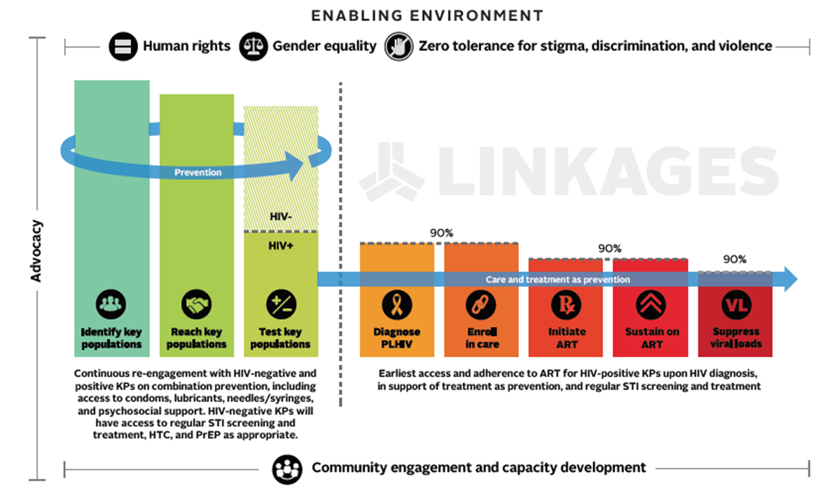
What Information Do We Really Need?
Prevention
Testing
Linking to Treatment
Notes:
We need to collect information that will help us implement programs and generally, the further to the right you move on the cascade, the more detailed and specific information you need. To provide someone with meaningful HIV treatment and support for life you need to know who person is, their phone number and maybe even information about where they live. They need to have a medical record that may have other personal details as well. Although the global recommendation is that KPs not be identified as so in public health services, HIV programs often follow their clients into health services and client status as a KP can be widely known by health providers.
A nuanced program looks at downstream risks that arise from programmatic need. We need to articulate better what data can and should be presented as aggregate and what data needs to be linked to individuals. Since for treatment we need to know more individual data it may therefore be ethically sound to take those risks. For prevention it is less so. KP communities have strong opinions about this topic and they must be engaged in decisions about how much identifying information is reasonable and safe for different steps in the cascade.
Functional plans that balance risks and benefits to the individual and society, and follow the lead of KP communities are necessary. Although it is common for research, rarely do KP programs have Data Risk Reduction Plans that justify the information collected at each point in the cascade and describe actions taken to protect the information.

Slide 8
Who Needs Access to the Data?
KP communities
Field staff (peer educators, peer navigators, service providers)
Project staff
Researchers
Ministry of Health or other government agencies
Donors
Access should be limited to a “need to know” basis.
Notes:
There are lots of people who need access to the data collected by programs. KP communities need access to their data so that they can participate actively in their programs. Field staff with different jobs need different types of information. The majority of project staff don’t need access to all the data and government agencies and donors usually only require aggregate data for reporting. As a rule, access to identifying data should be limited to data related the people they are serving directly. So if a peer educator’s data is stolen, the data breach is limited in size and scope.
I know they sounds pretty obvious but I have seen many examples where these principals have not been followed. When too many people have too much access, the risks are tremendously increased. Who Needs Access to the Data should be clearly articulated in program’s Data Risk Reduction Plans and this should be audited as part of data quality assurance activities.

Slide 9
How Do We Protect the Data?
Lock up paper forms and equipment
Password protect files and equipment
Encryption
Consider protocols that allow for phones or computers to be erased from afar (like Find my iPhone)
Data to be kept in encrypted cloud instead of on computers or phone
What actions will the project take in the case of data breeches?
Notes:
I’m not an expert in the technologies that facilitate protection of electronic data, but I think it can be safely said that technology can’t help us with a lot of the risks we see in the field, because so much relies on human factors. Your data can be password protected, encrypted and on computers that are kept in a locked filing cabinet, but if a person with access to those passwords is threated or tortured, or if someone has a careless moment, that data won’t be safe. Protocols need to be in place for when there are breeches in data security – and these will happen despite our best efforts. How can we make sure that we limit the scope of breeches? And what is our responsibility to the people and institutions whose data may have been breeched and how do we inform them of serious breeches if they happen? This all needs to be part of the Data Risk Reduction Plan.

Slide 10
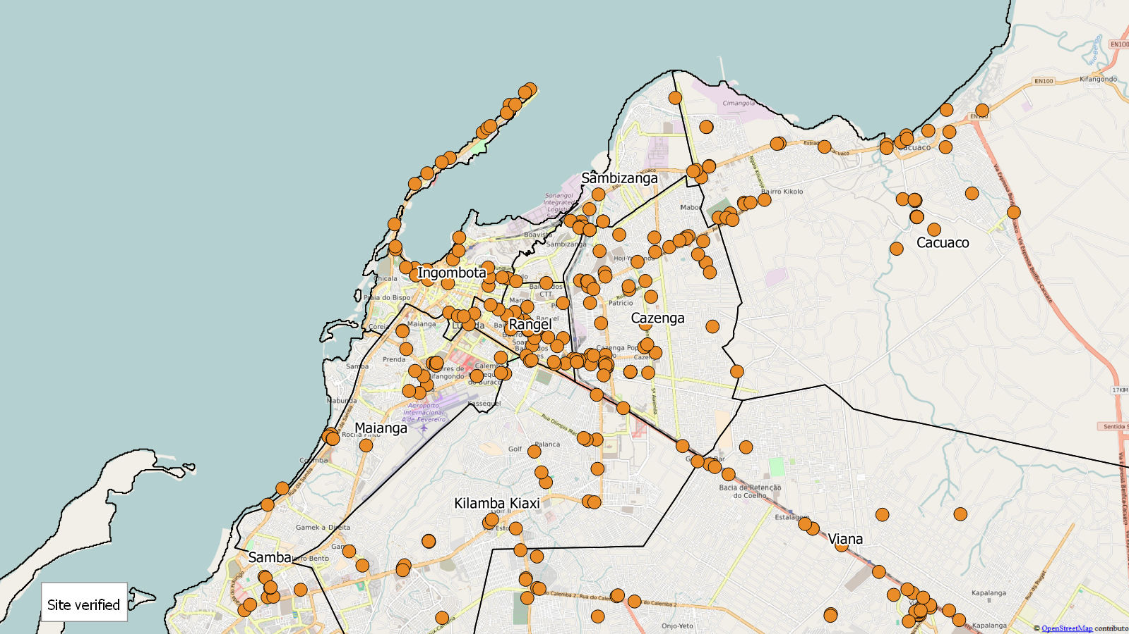
GIS Data and Going Online
Luanda, Uganda: MSM and TG sites, n=396
Notes:
With the advent of GIS we have new and exciting ways to identify and track where service are offered, ensure that program staff are visiting “hotspots”, track HIV prevalence in service delivery sites, and even offer clients the opportunity to look at a map and “click” on services near them to book appointments, etc.
But these maps also tell people who may not have KP’s interests in mind where KPs socialize, work, or inject drugs. We need to be tremendously careful about the granularity of the data shared – even in published research reports. The use of GIS and a thoughtful analysis of the benefits and risk of GIS data also need to be part of the Program’s Data Risk Reduction Plan.

Slide 11
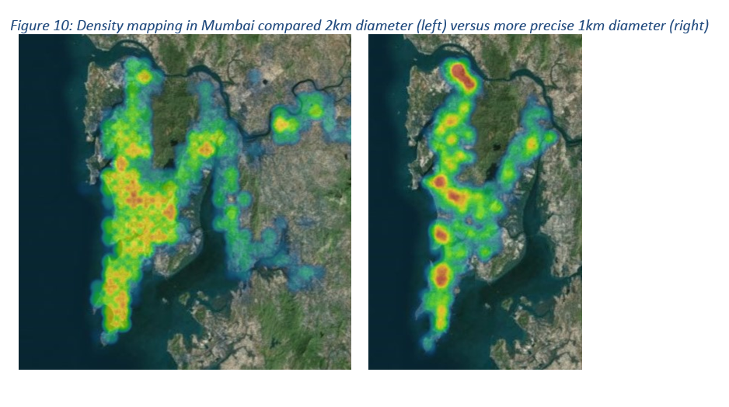
Density Mapping in Mumbai - Improved Methodology
LINKAGES has improved the precision of density mapping approaches to allow HIV programs to more easily identify clusters of dating app users
November 2017
December 2017
Notes:
I imagine that everyone in this room has heard horror stories about KPs – and particularly sex workers and MSM – being solicited on a social media or networking apps by people who do them harm. This is a serious concern for programs who choose to use these platforms for outreach.
Likewise, the advent of social media and other networking apps creates exciting opportunities for the visualization and use of KP data. For example, in Mumbai, LINKAGES developed a new way to visualize the density and estimate the number of location-based Grindr users to help:
Guide outreach workers on where and when to set their phones’ GPS location to find high number of dating app users for outreach
Target ads on dating apps to high density pockets that are nearby existing HIV testing campaigns and events
Estimate the number of active users across cities in India at certain days/times so we can have a better estimate of our population size.
This was done with the active involvement and collaboration of MSM groups in India and with a goal to insure that the data is aggregate and not detailed enough to identify any particular user or hotspot institution. But these maps could be more granular if we wanted them to be. How granular your data should be is an issue to discuss with local KP partners and to include in the program’s Data Risk Reduction Plan.

Slide 12
Unique Identifier Codes and Biometrics
Unique identifier codes can help track individuals across the cascade – but they are also imperfect
Biometrics are popular, but the risks in rights-constrained environments often don’t justify their use AND KP groups generally oppose them
Notes:
At this point you are probably wondering why I haven’t yet talked about two really big issues in KP programs – Unique Identifier Codes and the use of Biometrics.
We use Unique Identifer Codes in my project to track people across the cascade from one service to the next and some may argue that they are under-utilized. They can help provide some anonymity to the information collected about clients. But my experience has been that most projects still have names associated with UICs somewhere in the program files.
Biometrics are a much bigger and more controversial issue. As a program leader I have even found myself daydreaming about how much easier it would be to track people across the cascade of HIV services if we were able to use a biometric like a finger print. Nowadays people are also using exciting biometrics like iris scans and palm prints. I see the benefits to biometrics, but frankly, the risks to KPs in rights constrained environments is even larger. And in the face of criminalization, taking fingerprints or other biometric information is loaded with negative meaning for KPs and potential harm. Insisting on biometrics may keep people in need of services away. In my opinion, and in the opinion of most of the global KP advocates I’ve worked with, the risks and negative optics of biometrics usually outweigh the benefits. And this applies beyond the confines of programmatic activities. Researchers often argue for the use of biometrics for BBSs and other KP research when really there are equally good methodologies that do not require biometrics. As a community of KP implementers we MUST listen to the concerns of the communities we work, and when they say “no” we must respect that.

Slide 13
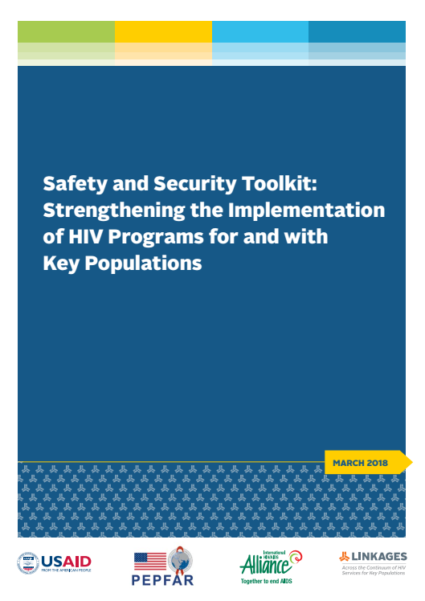
www.fhi360.org/linkages
Notes:
So… recognizing all the risks I’ve mentioned this evening but also all the opportunities provided by collecting and using data safely and securely, earlier this year LINKAGES did an audit of the 170+ civil society organizations we are funding and discovered that only a very small handful of them had safety and security plans that addressed issues like data security. Through the LINKAGES Violence, Stigma and Discrimination Technical Working Group; and working in partnership with the International HIV Alliance; we held a consultation meeting with 40 representatives from MSM, SW, TG and PWID groups from Africa, Asia and Latin America and developed a Safety and Security Toolkit to strengthen the implementation of HIV programs for and with key populations. The toolkit includes checklists, tools and case studies to help organizations (and their KP constituents) review safety and security protocols and develop low cost and no-cost action plans to make improvements, including to data security. Internally we started to roll this out in March and since then more than 80 CBOs that have assessed themselves and developed program Data Risk Reduction Plans which we plan to track over the remainder of the project. Going forward, a Data Risk Reduction Plan will be a required element of any financial award to the CSOs we work with.
Please take a look at the toolkit which is on the LINKAGES website which may be able to give your programs and even research activities some ideas about how to improve data safety in rights-constrained environments.

Slide 14
Thank you
Stefan Baral
Navindra Persaud
Virupax Ranebennur
Ben Eveslange
Matt Avery
Purvi Shah

Slide 15


Stay Connected with LINKAGES
Follow LINKAGES on Twitter:
www.twitter.com/LINKAGESproject
Like the project on Facebook:
www.facebook.com/LINKAGESproject
Subscribe to the LINKAGES blog
www.linkagesproject.wordpress.com
Subscribe to The LINK, LINKAGES’s quarterly
project e-newsletter
Check out LINKAGES’s quarterly research digest

Slide 16







